Slide 1

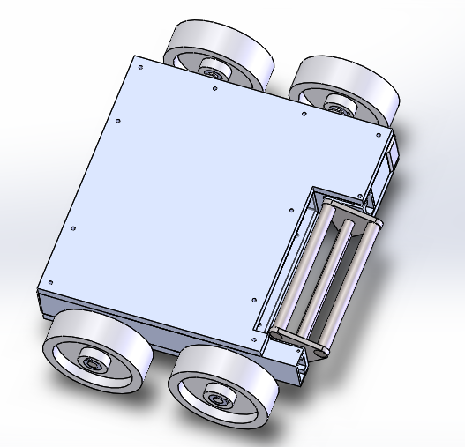
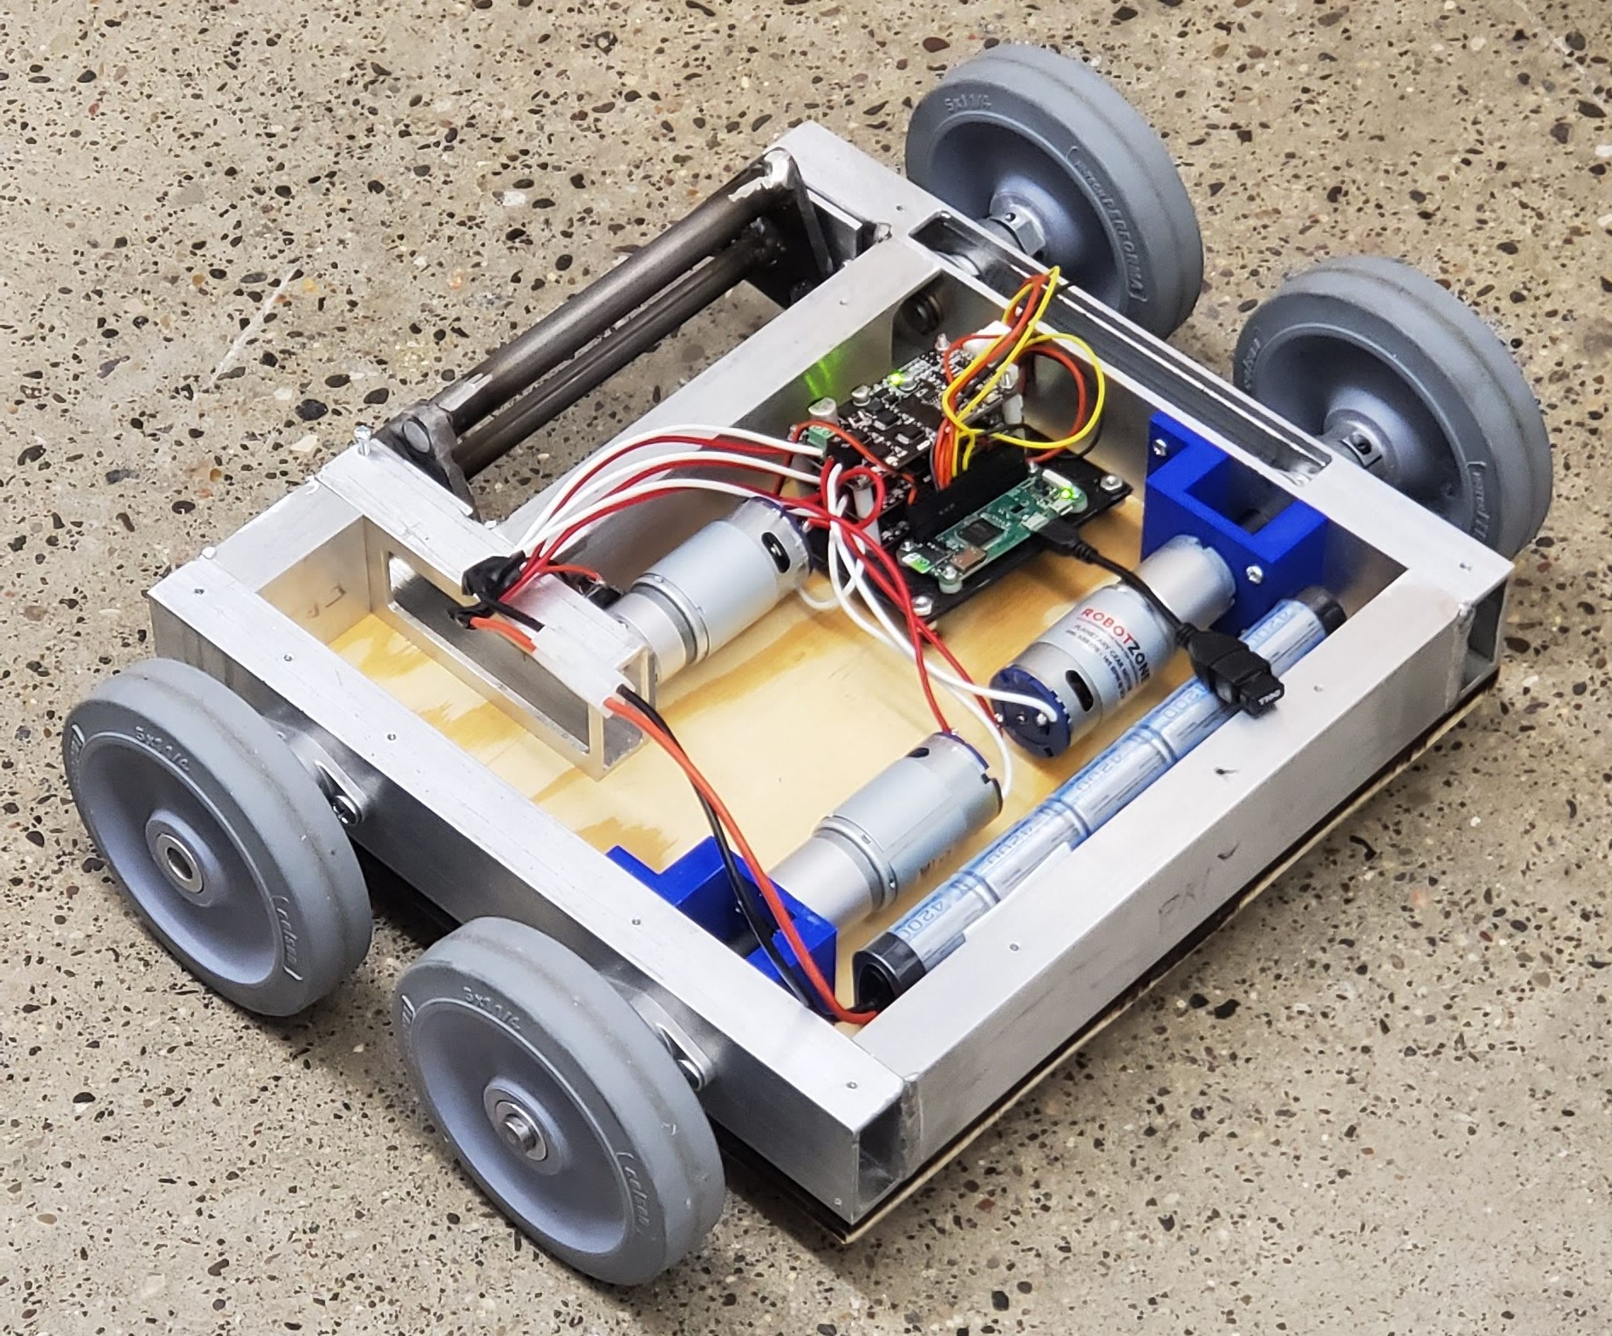
Battlebot Team 3
EMEC 499- Capstone 2
Instructors : R.Larson and C. Shankwitz
Faculty Advisor: James Black
Group members: Nishagar Raventhiran, Ivan Albert, Cole Trugman
Date : April 25th 2019
Design
Testing
Offensive/defensive Specifications:
The robot must be able to push with a force of 20 lb to ensure it can move opponents and obstacles. This is based on rubber on asphalt having a coefficient of kinetic friction between 0.5 and 0.8. (25lb * 0.8 = 20lb)
The robot can also withstand 20 lb of pushing force from opponent, based on friction and motor stall torque.
The robot must be able to withstand at least 25 lb added weight in case another bot gets on top of it.
The robot must move under its own power at ≥ 1 foot per second.
Assembly Specifications:
The battery should provide enough power to run the robot for 3 minutes continuously and be replaceable or chargeable in under 5 minutes.
The turning radius must be at most 3 ft
Interface Specifications:
The robot must include a master power disconnect switch
The control system must interface with driving motors as well as a remote control, which must maintain a reliable connection over a distance of at least 33.28 ft. This was calculated by finding the corner to corner span of the arena and adding 5 feet
Material Specifications:
Device (Not including peripheral equipment) must weigh between 20 and 25 lb to meet requirements and not be pushed around easily.
Device must stow into an 18” cube.
Device must not have sharper than 1/8” radius edge.
Device should cost between $500-$1000
Figure 1. Solidwork model of the Battlebot
10” X 8” image size
Background
There will be 3 battlebot groups presented with the task of defeating each other’s bots in combat.
This requires sticking to the guidelines presented by the competition, disabling opponent bots, and surviving to fight another round.
In addition to the opponents, several environmental hazards will also be present in the arena that can damage or destroy robots that get too close to them.
.
Design alternatives considered for the Battlebot are summarized as a table below.
Design | Drive System | Electrical System | Weapon | Armor | Total Points
Design 1 | Dead Axel: Wheels | Microcontroller: Bluetooth | Roller | Aluminum
 | 9 | 8 | 9 | 4 | 30
Design 2 | Omni Wheels | Microcontroller: Radio | Hammer | UHMWPE
 | 1 | 6 | 7 | 2 | 16
Design 3 | Dead Axel: Wheels | Microcontroller: Bluetooth | Hydraulic Wedge | 1018 Steel
 | 9 | 8 | 1 | 2 | 20
Figure 3. Your captions stand out better in boldface. Try to make your poster communicate as much as possible graphically. Use graphs, charts, photos and simple illustrations.
Level one requirements
Final Product
The batlebot should:
Be less than 25 lbs
Fit in 18 in cube
Be able to move under its own power
Be able to be controlled remotely
Adhere to weapon limitations:
  No flames or flaming liquid
  No chemical weapons
  No untethered projectiles
  No explosives or explosively-driven weaponry
  No blades, spears, or edged weapons
Cost less than $1000
Be able to run for 3 minutes on one charge
Not be a pre-assembled robot or toy
No unsportsmanlike conduct is allowed.
While manufacturing the bot, the team decided to go with wood as armor plates. This allowed reducing the weight of the robot, and by stacking up 3 layers of woods, it can handle the hits from the opponents.
The robot is designed to take hits from opponents, but was designed to easily replace parts if needed between rounds so it can fight until the end of the competition.
Figure 4. Final Product as the Battlebot ready for the competition
ACKNOWLEDGMENTS
Research reported in this publication was supported by the National Institute of General Medical Sciences of the National Institutes of Health under Award Number P20GM103474. The content is solely the responsibility of the authors and does not necessarily represent the official views of the National Institutes of Health.
Figure 2. Battlebot during assembly

